Slide 1
Ur Voice
Presenter: Peter Harlan

Slide 2

Outline
Implementation (Languages and etc.)
Database Design
Main Interface
Algorithms
Known Problems
Demo
References

Slide 3







Implementation (language and etc.)
jQuery & JavaScript
Function
CSS
Style
handlebars
Content
Bootstrap
Function and style
MySQL
Database
Node & NPM
Backbone of Server

Slide 4
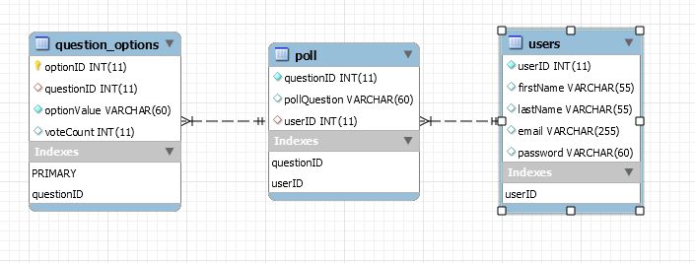
Database Design

Slide 5
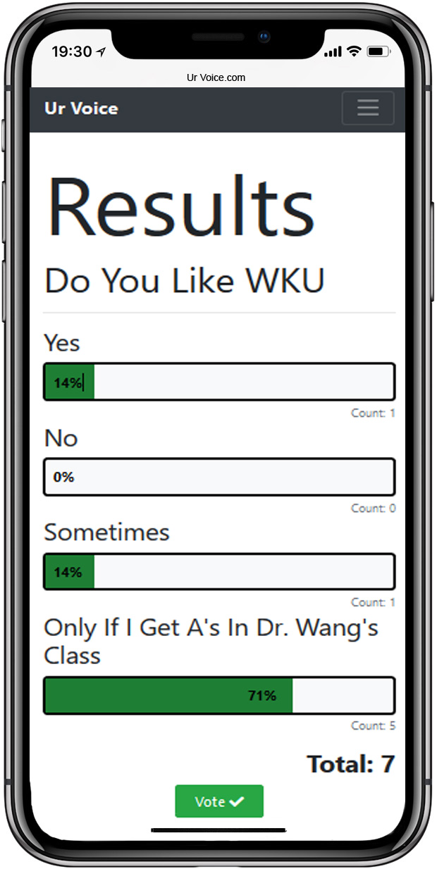
Main Interface: Results
Each Vote count for each option is passed from Node to Handlebars (percentage is not calculated by Node).
Onload, browser’s JavaScript:
Calculates total number of votes
Calculates percentage for each option in relation to total (up to 99% accuracy).
Add percentage text to graphs
Sets bar width equals to percentage
Plays animation to indicate bar percentage

Slide 6

Algorithm
If the user makes a bad request
Redirect to 404 page
If the user is not logged in
Redirect to a message page, “Please log in”.
If everything is good, process the request and return a response

Slide 7

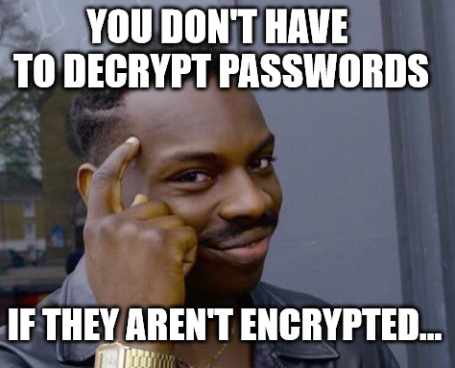

Known Problems
Overall, the defined requirements are met and don’t have any significant issues besides…
Known problems not related to requirements:
Restrict users to only one vote per poll
Hash passwords
Email verification
Captcha on account creation

Slide 8

Demo

Slide 9
References
< https://getbootstrap.com/>
<https://www.sublimetext.com/>
<https://www.w3schools.com/>
<https://www.kisspng.com/free/jquery.html>
<https://imgflip.com/memegenerator/Roll-Safe-Think-About-It>
<https://www.iconsdb.com/green-icons/checkmark-icon.html>
<https://egghead.io/browse/platforms/node>
https://www.google.com/url?sa=i&rct=j&q=&esrc=s&source=images&cd=&ved=2ahUKEwi0ub-t-ofeAhVE4oMKHT4PBXsQjxx6BAgBEAI&url=https%3A%2F%2Fblog.fossasia.org%2Fhandlebars-js-used-in-open-event-web-app%2F&psig=AOvVaw0-3TpzTaZA-7M30AU3aU1g&ust=1539676035141038
<https://marketplace.visualstudio.com/items?itemName=eg2.vscode-npm-script>
< https://icon-icons.com/icon/dbs-mysql/50909>
< https://www.idownloadblog.com/2017/11/17/iphone-x-app-switcher-secret-gesture/>

